Slide 1


Team Name -
Synergy⚡
Team Members
Isha Dubey
Kishan Gupta
Abhishek Yadav
Darshan Sharma
Aditya Pratap Singh
“Surksha Sanket”

Slide 2

AI Based new generation security system

Slide 3
Advanced CCTV analytics solution
Design and develop a technological solution based on live CCTV feeds, that can automatically detect incidents related to street crime, violence, burglary, theft, infiltration, unauthorized access etc. and generate alerts to the nearest Police Station. The solution should also be able to generate a report and maintain a database that includes the nature of incident/crime, location, time, level of alert (i.e., low, medium, high risk alert) etc.
PROBLEM STATEMENT

Slide 4
Introduction
Our technological solution is to implement a video analytics software.
It uses AI and ML algorithms to analyze live CCTV feeds in real-time and detect different crimes.
The software can be programmed to recognize certain behaviors, such as someone breaking into a building , carrying a weapon, or behaving aggressively.
This information could be used to identify patterns and trends in criminal activity and help law enforcement agencies to deploy resources more effectively.

Slide 5
Proposed System
Real time live monitoring
Object Detection / Face Recognition.
Report and Alert Generation.
Integrating with existing system.

Slide 6
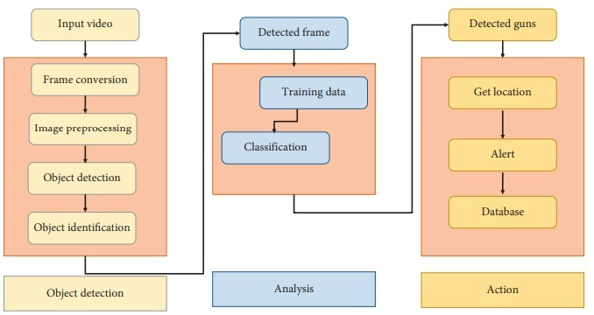
Work Flow :-

Slide 7


Solution Domain/Tech Stack Used
Dependencies
Open-Cv
Scikit-Learn
Tensor- Flow
Framework being used are Django
Machine learning algorithms used are
Yolo-v3 Object detection algorithm

Slide 8
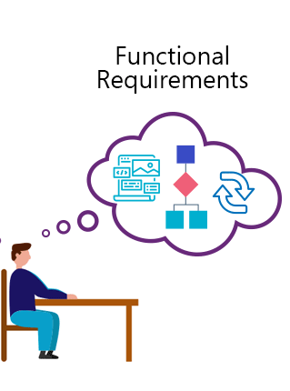
Functional Requirements
Camera including infrared sensor and high quality video processing
Data set for training the system

Slide 9
Key Points:
Weapon Detection
Iris Detection
Recognizing Wanted Criminal
Affordable and Scalable
Easy Implementation

Slide 10
Implement Costing
Software Costing
Serving Cost Costing
Testing and Validation Cost

Slide 11


Business Model :-
Government
Institutions
Crime Prone Location

Slide 12

THANK YOU

